Slide 1


Automating Scan-to-BIM for Telecom Site Planning
Chair of Circular Engineering for Architecture
Jeffrey Leisi
Midterm Presentation
Bachelor’s Thesis
03.04.2025
Notes:
Hi everyone, welcome to my midterm presentation on automating Scan-to-BIM for telecom site planning.
This project is a collaboration with Axians, one of the leading ICT companies in Switzerland.
I worked there for several years before I have started my studies in Geomatics.

Slide 2
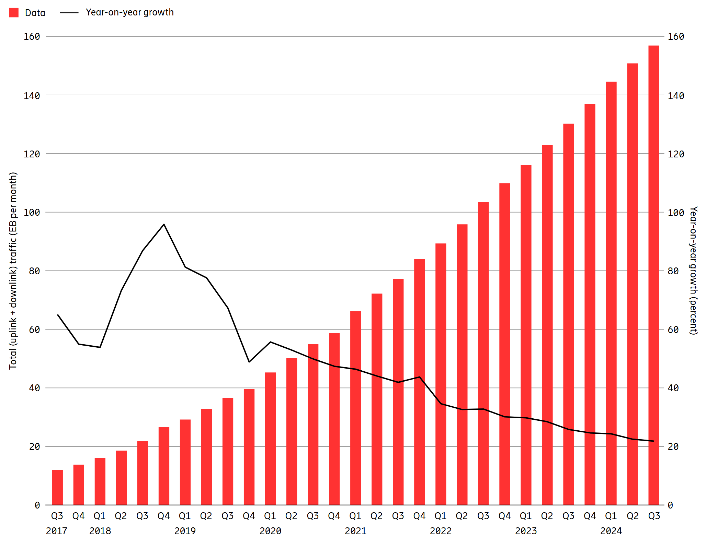
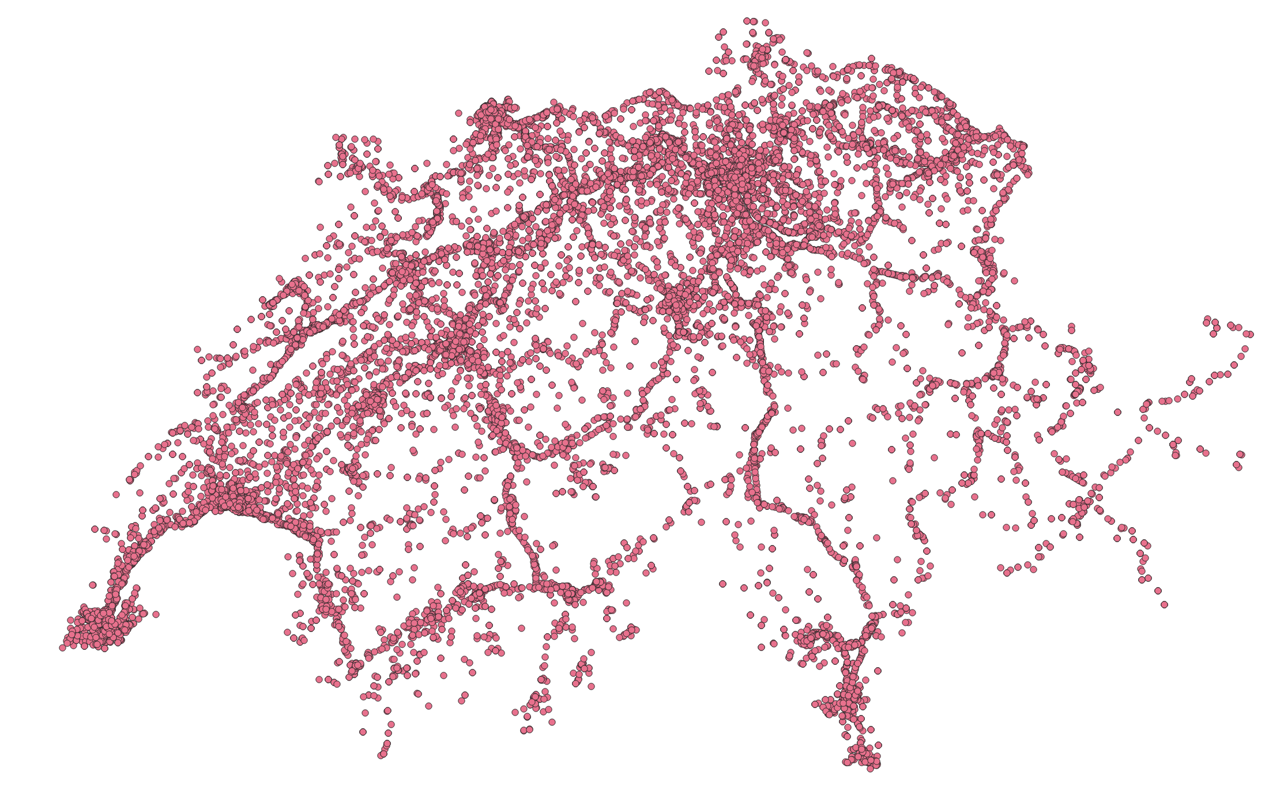
Motivation
Mobile data traffic increases
Source: Ericsson Mobility Report (November 2024)
Notes:
The latest numbers from Ericsson have shown that global mobile data traffic is still growing rapidly.

Slide 3
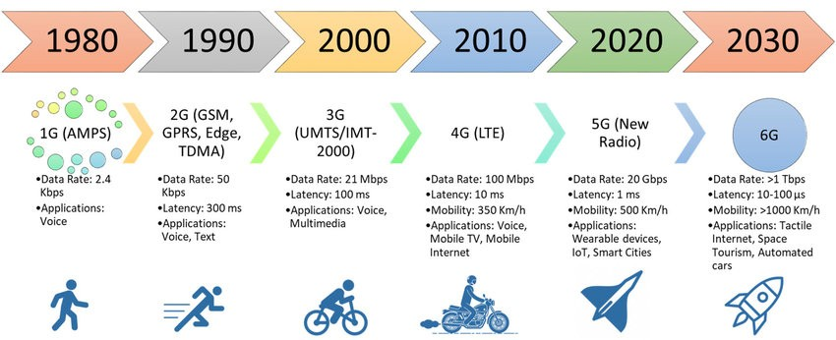
Motivation
Currently relevant
Mobile data traffic increases
New technologies (shift toward higher frequency bands)
6G
Source: https://www.linkedin.com/pulse/understanding-5g-glimpse-6g-evolution-connectivity-dr-manpreet-puri
Notes:
Because of that trend, a new mobile network generation is introduced roughly every 10 years. Currently, 4G and 5G are the most relevant technologies. 2G was phased out several years ago, and Swisscom will shut down 3G at the end of this year.
To increase the data throughput, a newer technology often uses a higher frequency band.

Slide 4
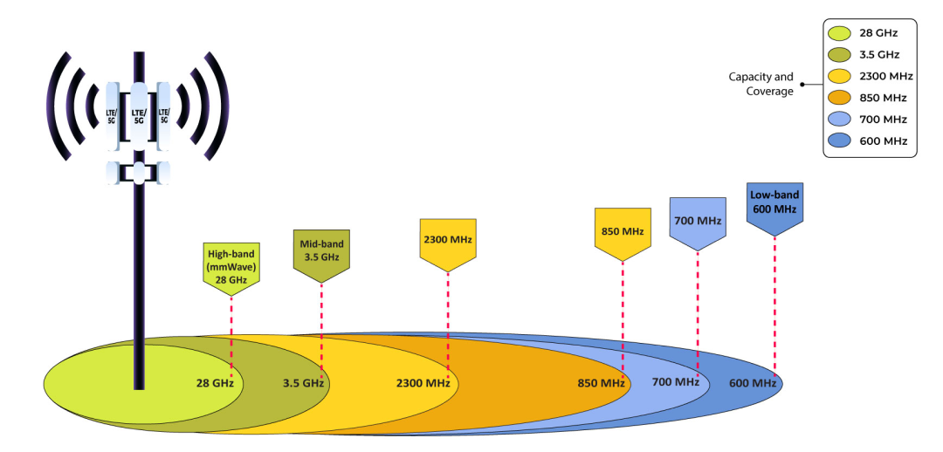
Motivation
Mobile data traffic increases
5G (high band CH)
4G (high band CH)
New technologies (shift toward higher frequency bands)
Decrease in range (stronger atmospheric attenuation)
Source: https://jethrojeff.com/
Notes:
But shorter wavelengths have a reduced signal range. That’s why a denser network is needed.

Slide 5
Motivation
Mobile data traffic increases
New technologies (shift toward higher frequency bands)
Decrease in range (stronger atmospheric attenuation)
More antenna sites required
~(7,500 new 5G sites: CHF 3.2 bn)
Conclusion: Large-scale deployment calls for efficient planning strategies.
Status quo: ~15,000 sites (> 5 W)
Source: Own GIS analysis based on data from https://data.geo.admin.ch/browser/index.html#/collections/ch.bakom.standorte-mobilfunkanlagen?.language=en
Notes:
Currently, there are around 15,000 macro cells in Switzerland, and several thousand more will be required for full 5G coverage.
So, there is a high demand of efficient solutions to plan sites.

Slide 6
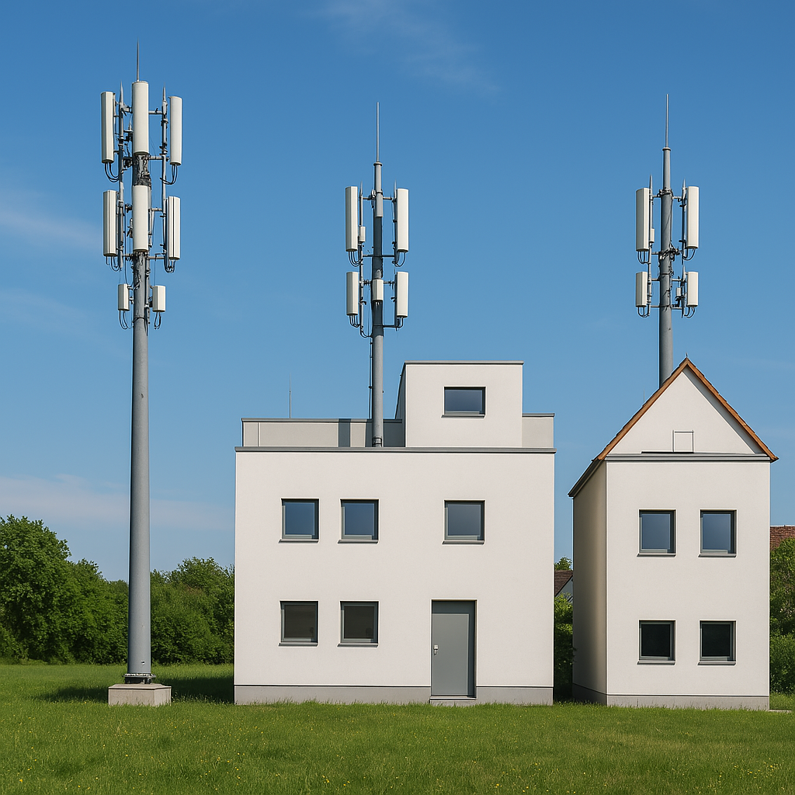
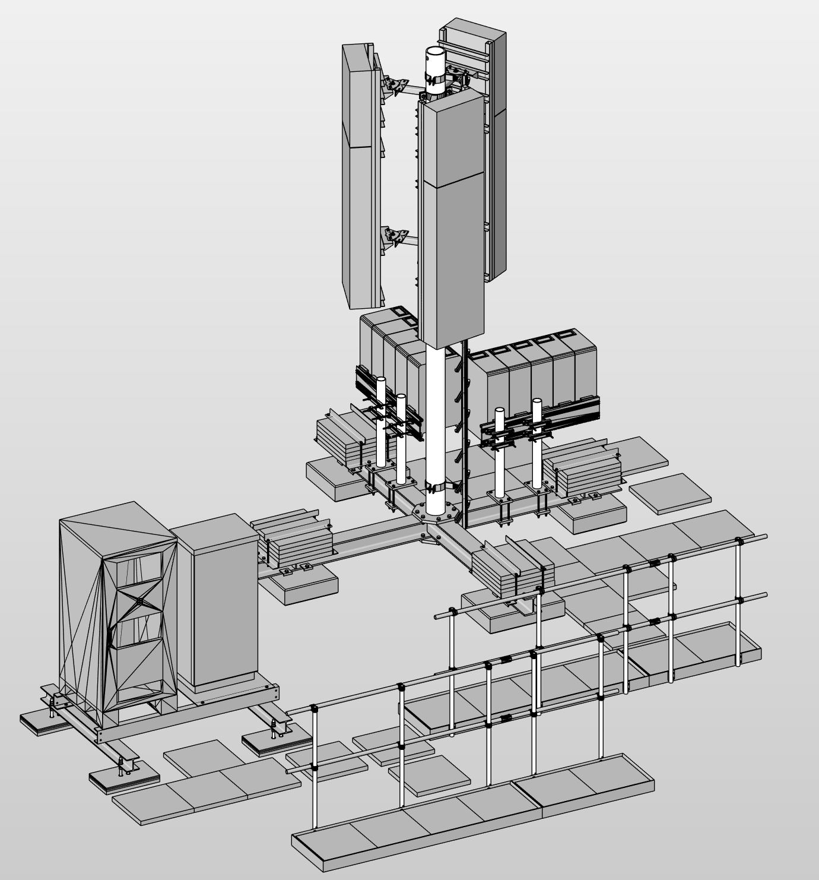
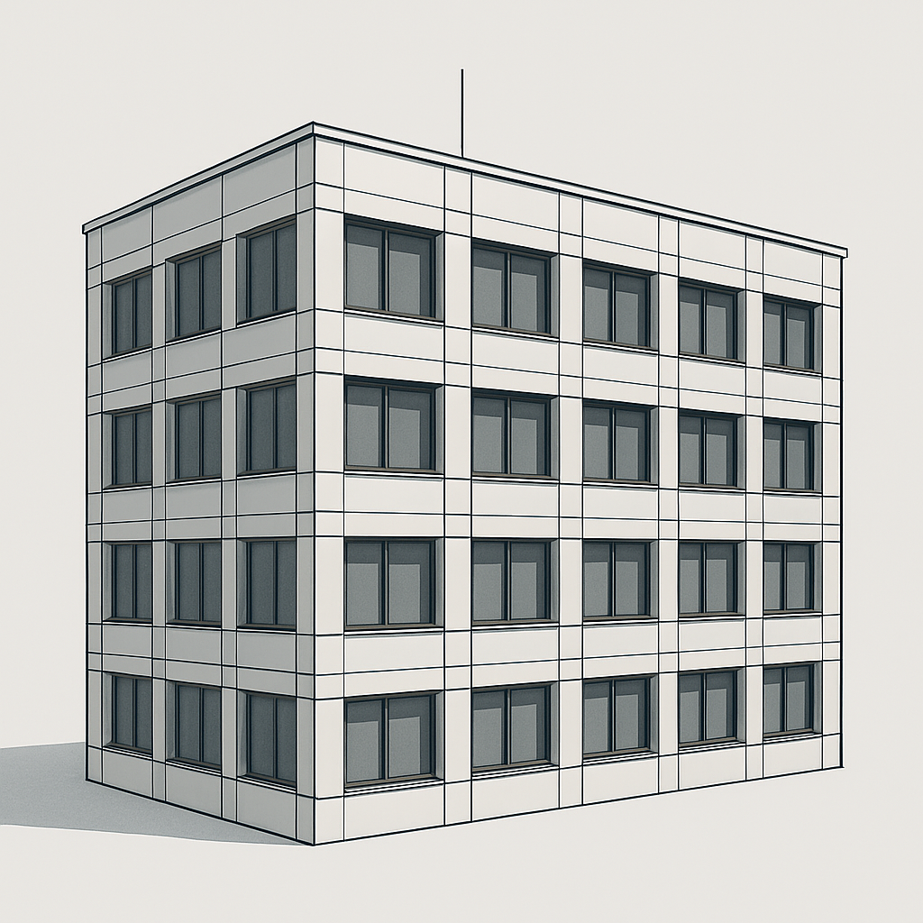
Cellular Sites
Base Station
Antennas
Pole
+
=
Thesis focus
Steel structures
Radio Access Network (RAN) Equipment
Building
Rooftop Site
mainly urban areas
Greenfield Site
mainly rural areas
Notes:
A site consists of steel structures and electronic equipment. If these components are installed on a roof, it’s called a rooftop site.
If the antennas are mounted on tower it’s called a greenfield site.
But the focus of this thesis is on thoses buildings - that’s why I’m here at IBI.

Slide 7
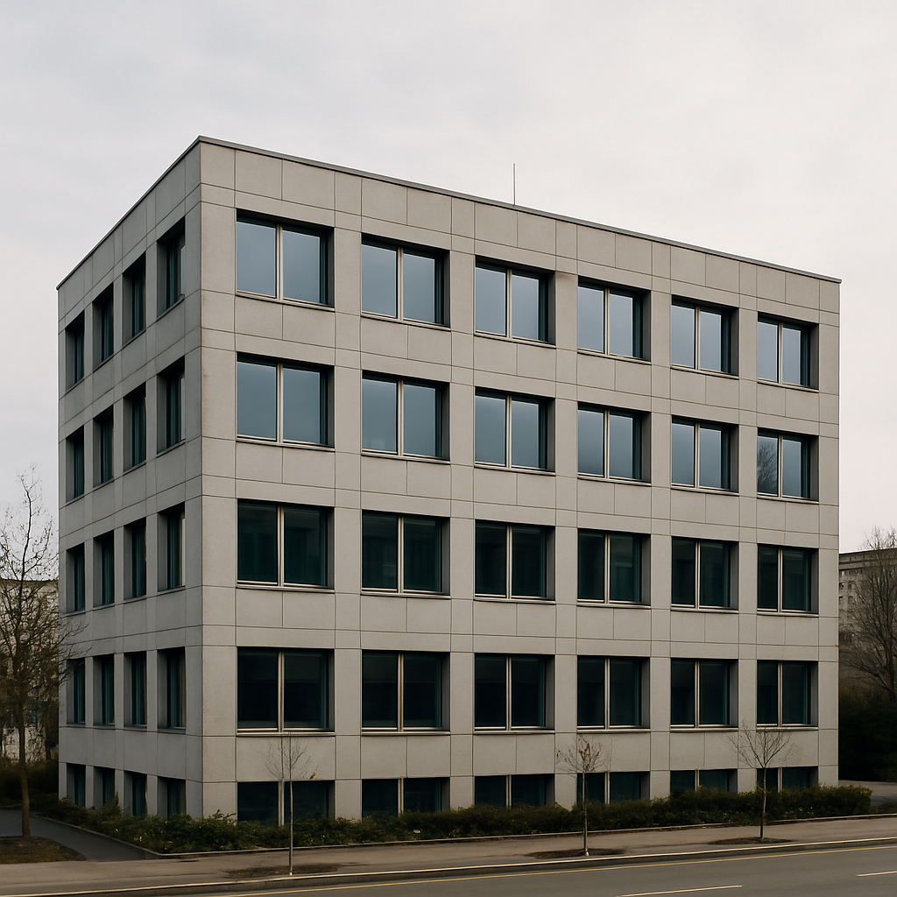
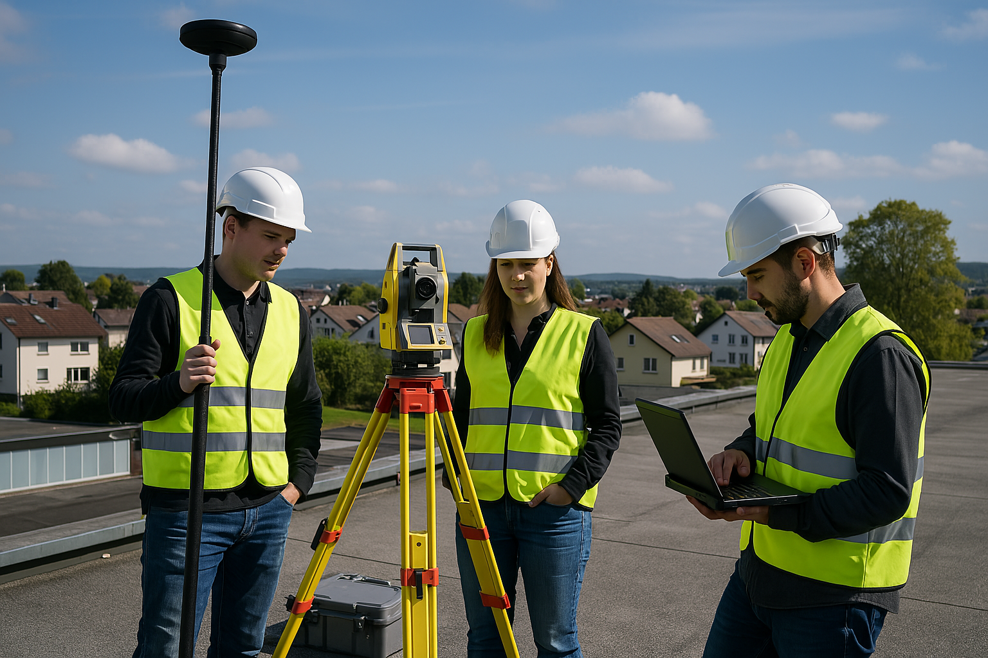
Problem Statement: Conventional Site Planning
Site Survey
Schematic Design
Technical Design
Execution & Operations
Building Permit
Site Survey: Site inspection with the provider, building owner, and a team of specialists
Drone-based environmental capture for non-ionizing radiation (NIR) calculation → Building point clout as a by-product
Geodetic survey with GNSS and total station
Attempt to organize existing building drawings
Notes:
Then, let’s have a look at the current site planning workflow.
After the provider has found a rentable location, a site survey is carried out.
This includes a lot of measurement.
For example, a drone captures the environment within a roughly 500-meter radius. This data is mainly used for radiation simulations, but it can be used as a by-product for building reconstruction too.

Slide 8
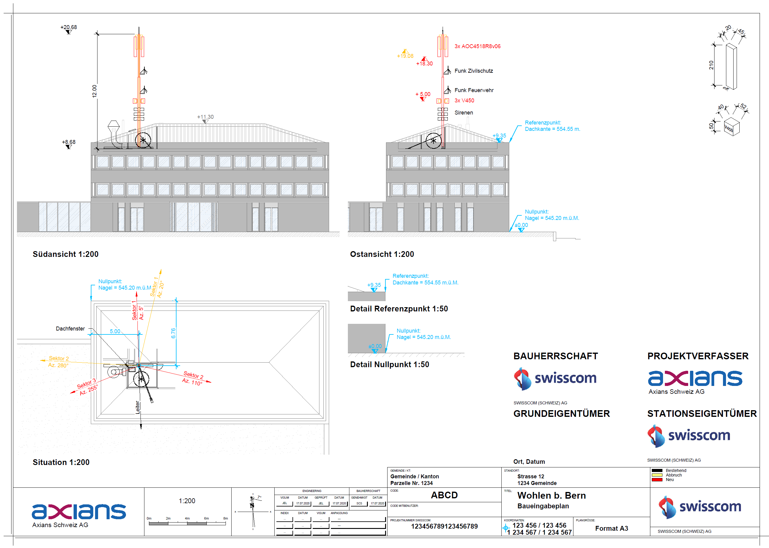
Problem Statement: Conventional Site Planning
Site Survey
Schematic Design
Technical Design
Execution & Operations
Building Permit
Schematic Design: Preparation for building permit application
Computer-Aided Design (CAD): Software for 2D/3D drawings
Average Case:
Scanning of paper building drawings
CAD-vectorization of digitalized building drawing (tracing)
Worst Case
1. Draw building from scratch with geodetic survey data
2D CAD Drawing
Building Reconstruction
Simplified Technical Representation
Notes:
After that, they create the building permit drawing using 2D CAD.
They need to draw views from the building façade.
If they are lucky, they got paper building drawings, which they can scan and redraw.
But sometimes, they have to draw the whole façade from scratch.

Slide 9
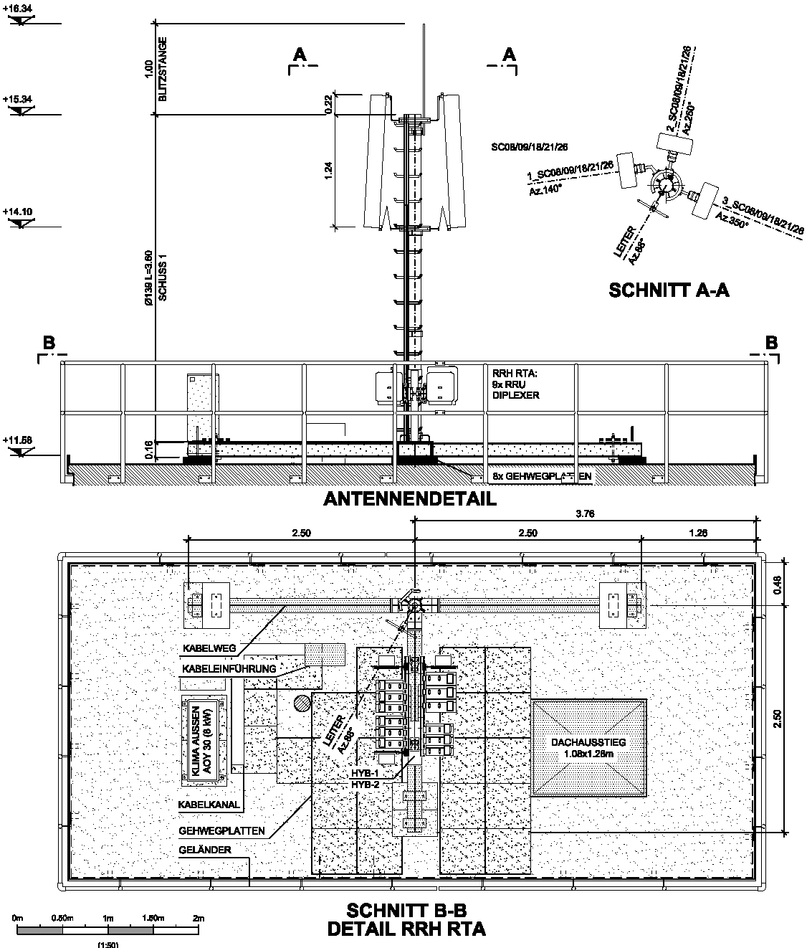
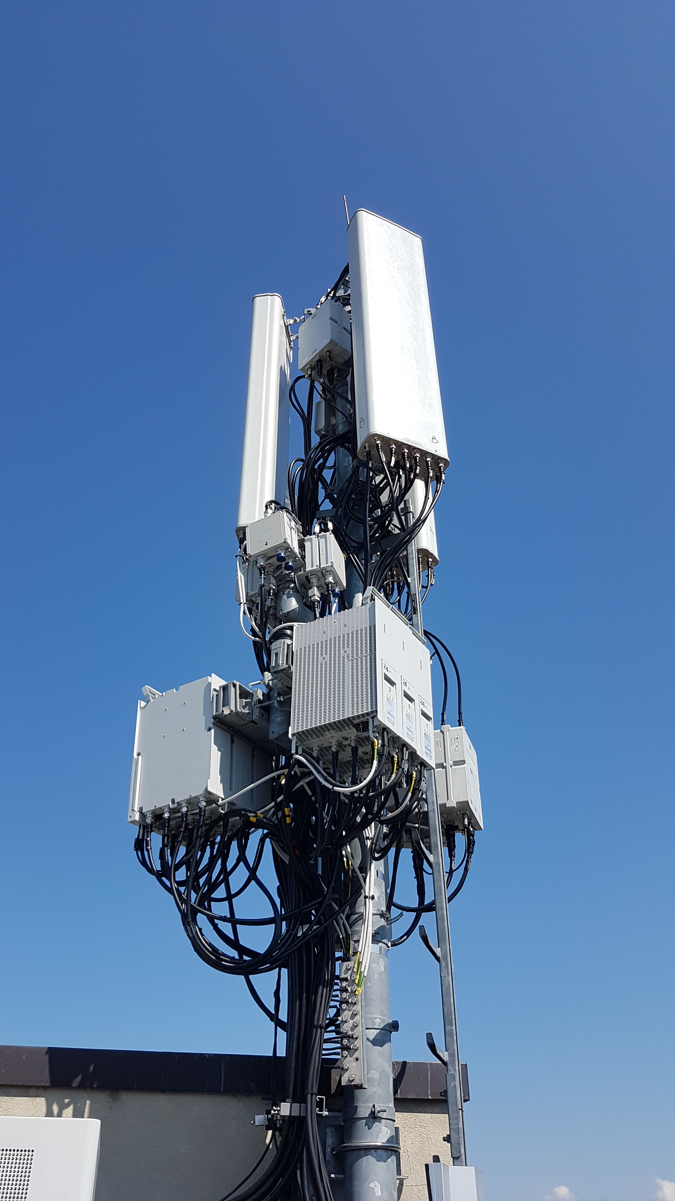
Problem Statement: Conventional Site Planning
Site Survey
Schematic Design
Technical Design
Execution & Operations
Building Permit
Technical Design: Preparation for execution
Planning of steel structure and RAN equipment.
Bills of materials must be manually derived from the drawings
High component density
Many standardized, modular components
2D CAD Drawing
Detailed technical representation
Bill of Materials
Notes:
After the building permit is approved, they begin with the execution planning.
There’s often a high component density. And working in 2D can become quite difficult.

Slide 10
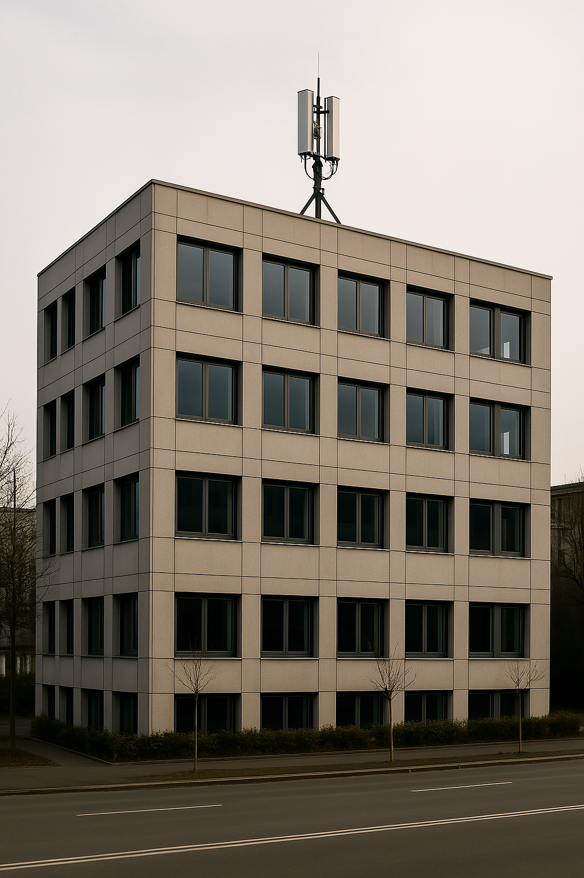
Problem Statement: Conventional Site Planning
Site Survey
Schematic Design
Technical Design
Execution & Operations
Building Permit
Execution: Construction and maintenance of planning documents.
Sites are operated over many years.
Technical modifications must be manually updated in the drawings (often in multiple views)
Conclusion
High dependence on third parties (building drawings)
Labor-intensive
Proposed Solution
Model-based site planning
Notes:
After the execution, a site remains in operation for many years. During that time, there are often technical upgrades, and keeping the CAD drawings up to date is time-consuming.
In conclusion we can say, that there is a need for more efficient methods.
A promising solution could be a model-based approach.

Slide 11
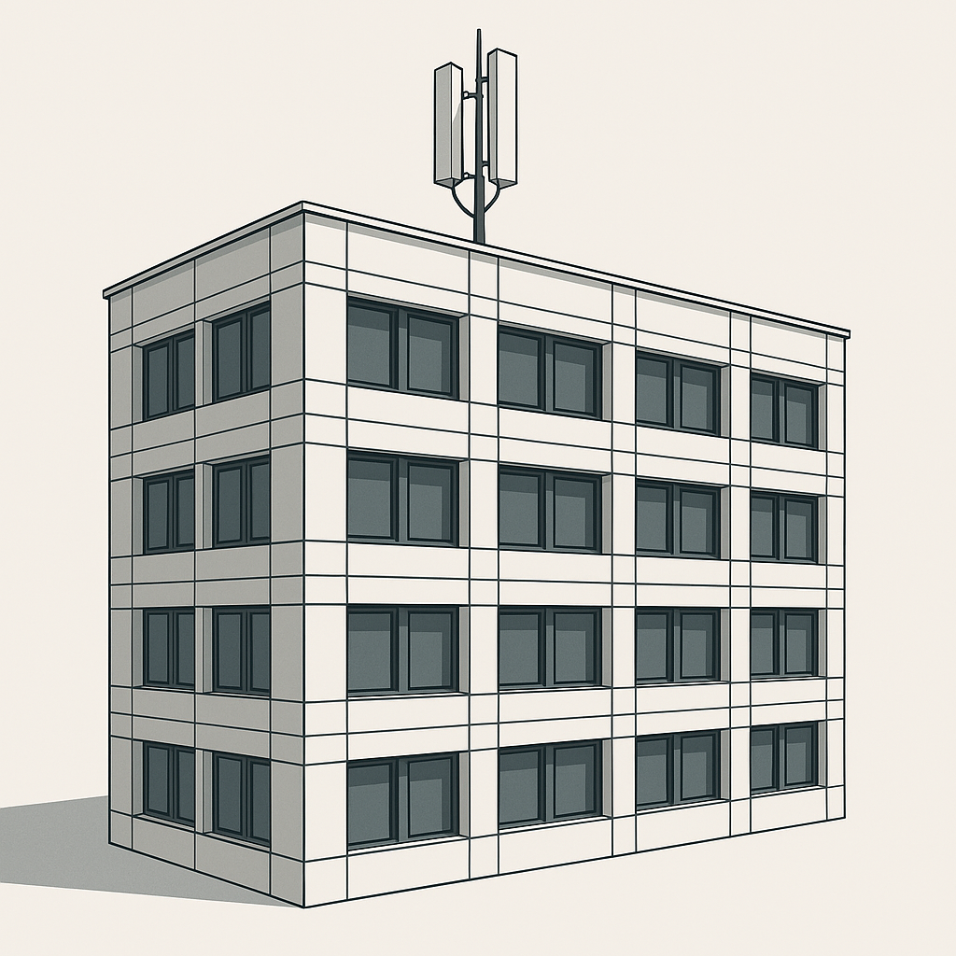
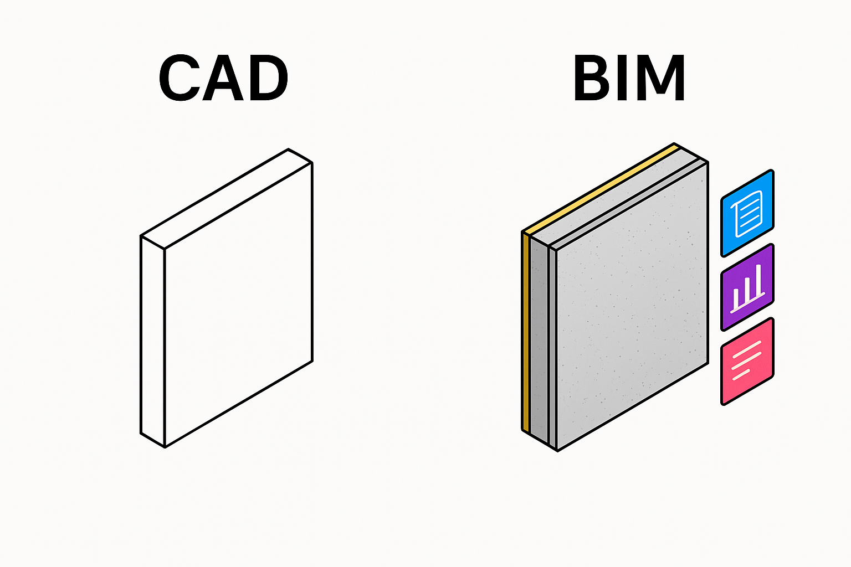
Proposed Solution: Model-Based Site Planning
Site Survey
Schematic Design
Technical Design
Execution & Operations
Building Permit
Building Information Modeling (BIM): Planning Method that works with a smart 3D model.
Process:
Generate a model from point cloud data
Automatically generate plans from the model
geometry
geometry +
information
Notes:
In CAD, the workflow is quite similar to drawing on paper.
It’s a collection of geometric primitives, like lines.
And these lines don’t know what they represent in reality - they’re so-called “dumb lines”. On the other hand, BIM goes a step further and adds semantics to the geometry. The entities are no longer just simple lines - they’re complete building elements like walls.
And once you have your model, you can automatically generate plans from it.
So, you can go from BIM to CAD but the other way around it’s a bit more difficult.

Slide 12
Proposed Solution: Model-Based Site Planning
Site Survey
Schematic Design
Technical Design
Execution & Operations
Building Permit
Scan-to-BIM
Process:
Technical design is already done using BIM
The process would be simplified if a building model were available
Scan-to-BIM: Converts building point cloud into BIM model
Conclusion
BIM has proven effective in the execution phase
No efficient solution for Scan-to-BIM has been found yet
The logical next step is the development of a Scan-to-BIM method
Notes:
So far, they use BIM already for the execution planning. And for their modelers, it would be much easier if they have access to a building model.
[click]
So, they are currently looking for a solution, that converts a physical object into a BIM model. This process is called Scan-to-BIM. It’s already well researched, but so far, no automated solution has been found. Developing such a tool is the goal of my work.

Slide 13
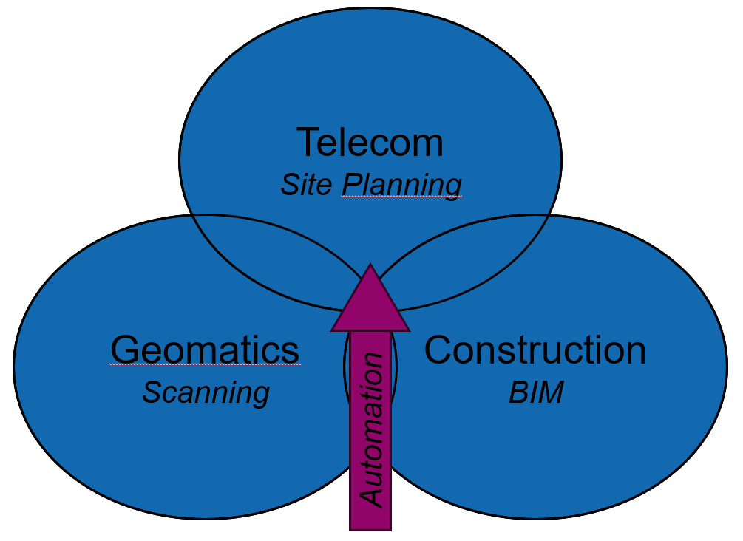
Research Questions
Main Research Question:
How can Scan-to-BIM be automated for telecom rooftop site planning?
Sub-Questions:
Which steps of Scan-to-BIM can be automated for rooftop site planning?
Which tools enable rooftop Scan-to-BIM automation?
Notes:
My research lies at the intersection of geomatics, construction, and telecommunications.
And it uses methods from geomatics and constructions to automize site planning.

Slide 14
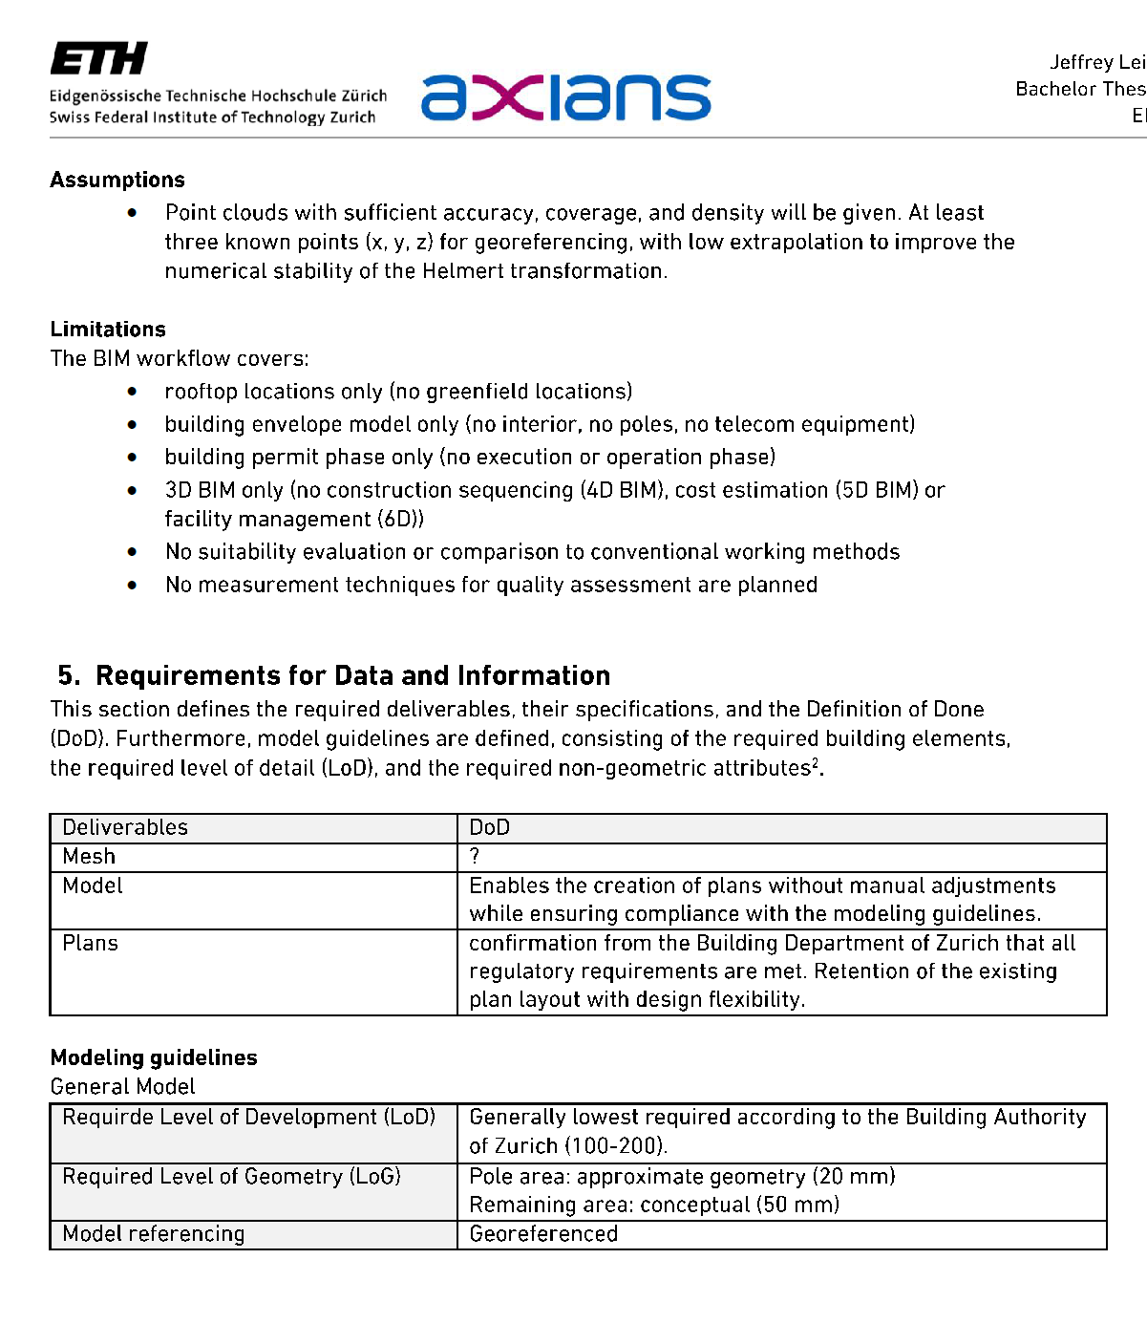
Design Science Research Methodology (DSRM) by Peffers et al. (2007)
Problem Identification
Objectives
Design and Development
Demonstration
Evaluation
Communication
Use of Exchange Information Requirements (EIR) to identify problems, objectives and artefacts
Problems
Inefficiency of conventional site planning
Lack of commercial solutions for automation
Objectives
Tool that converts point clouds into a BIM model
Artefacts
Scan-to-BIM Framework
Python-Script
Notes:
As a methodology, I’m using a framework called Design Science Research Methodology.
It consists of six concrete steps that guide the development of an artefact.
At the beginning of the project, I used a BIM tool called Exchange Information Requirements to specify the project with the employer. -> Pflichten- und Lastenheft

Slide 15
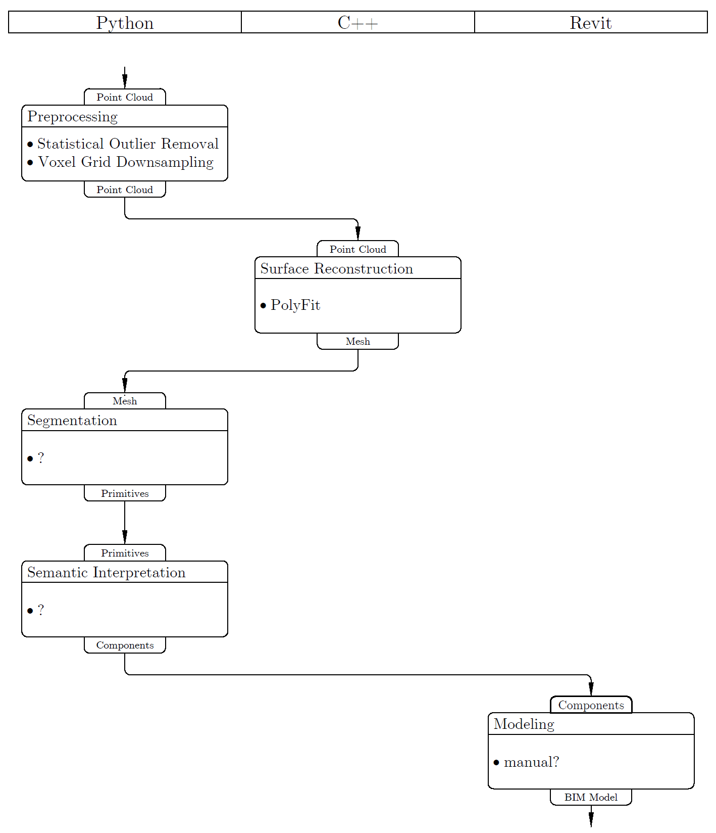
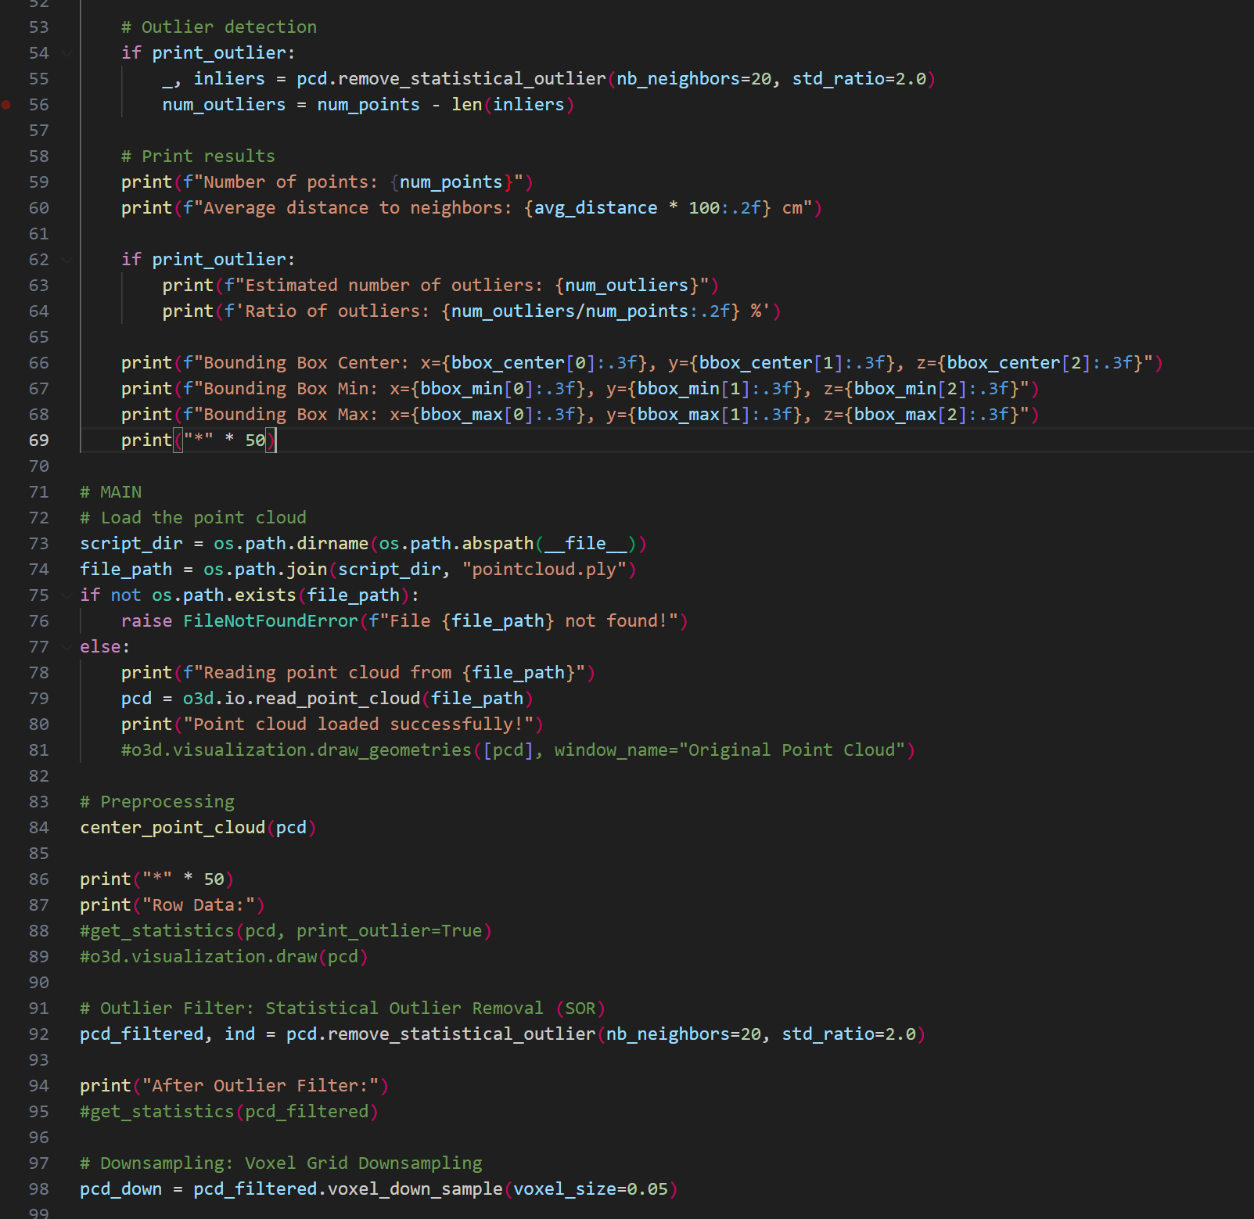
Design Science Research Methodology (DSRM) by Peffers et al. (2007)
Problem Identification
Objectives
Design and Development
Demonstration
Evaluation
Communication
Artefact 1: Scan-to-BIM Framework
Development of a Scan-to-BIM framework based on the current state of research
Artefact 2: Python Script
Concrete implementation of the developed framework
Notes:
Currently, I’m developing two artefacts:
A Scan-to-BIM framework
Its implementation
The framework is based on a literature analysis. And the implementation is mainly done in Python.

Slide 16
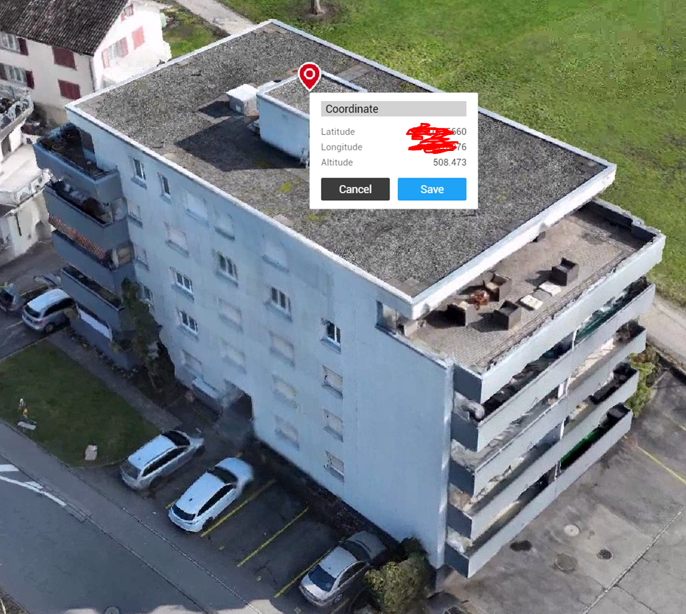
Design Science Research Methodology (DSRM) by Peffers et al. (2007)
Problem Identification
Objectives
Design and Development
Demonstration
Evaluation
Communication
Applying the developed artifact in a real-world case study.
The point cloud is provided
Notes:
Then, I will apply the artefacts to a real-world case study - this building.

Slide 17
Design Science Research Methodology (DSRM) by Peffers et al. (2007)
Problem Identification
Objectives
Design and Development
Demonstration
Evaluation
Communication
Evaluation of the demonstration
Evaluation methodology yet to be defined
Notes:
At the end, I will evaluate the case study and aim to translate the practical insights into scientific knowledge.
But, I don’t know yet how I wanna do this.

Slide 18
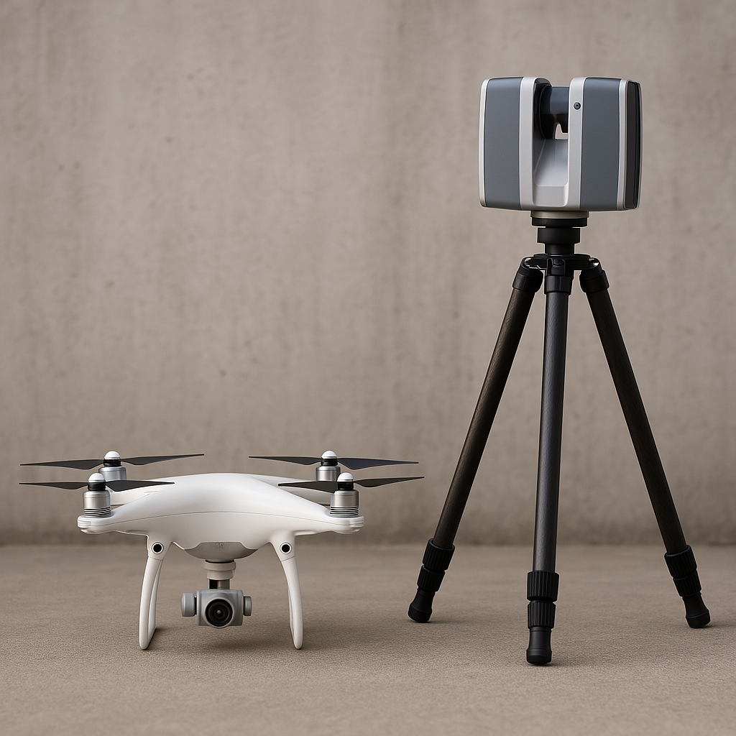
Scan-to-BIM Framework
Data Acquisition
Preprocessing
Geometric Reconstruction
Semantic Segmentation
Modeling
Building
Point Cloud
Reality Capture: Captures the real world and represents it as a point cloud
Photogrammetry: Captures the real world using overlapping images
LiDAR: Scans the environment using laser pulses
Notes:
My framework starts with a point cloud that is generated with photogrammetry from a drone.
I will get this data, so I don’t have to design the reality capture.

Slide 19
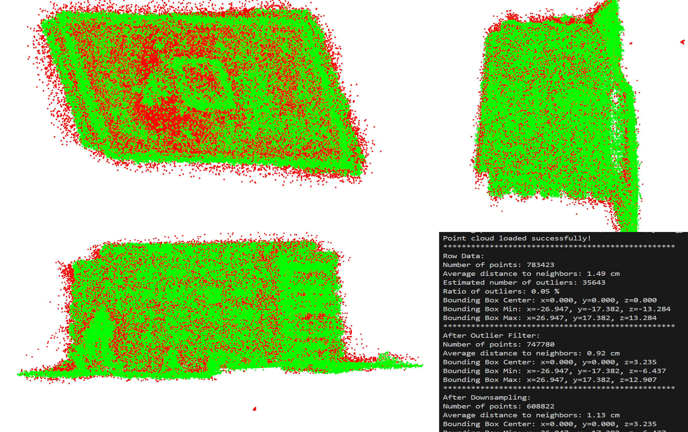
Scan-to-BIM Framework
Data Acquisition
Preprocessing
Geometric Reconstruction
Semantic Segmentation
Modeling
Point Cloud
Point Cloud
Preprocessing: Prepare data for further processing
Outlier Removal: Removing far data points Statistical Outlier Removal (SOR)
Downsampling: Reducing the amount of data Voxel Grid Downsampling
Notes:
After that, I use two methods to prepare the data for further computations.
First, I remove outlier with a statistical outlier removal
It computes the average distance from each point to its k nearest neighbors. If that distance is more than 3 standard deviations above the global average, the point will be removed.
Second, I do a voxel grid downsampling. It creates a voxel grid and retains only one representative point per voxel.

Slide 20
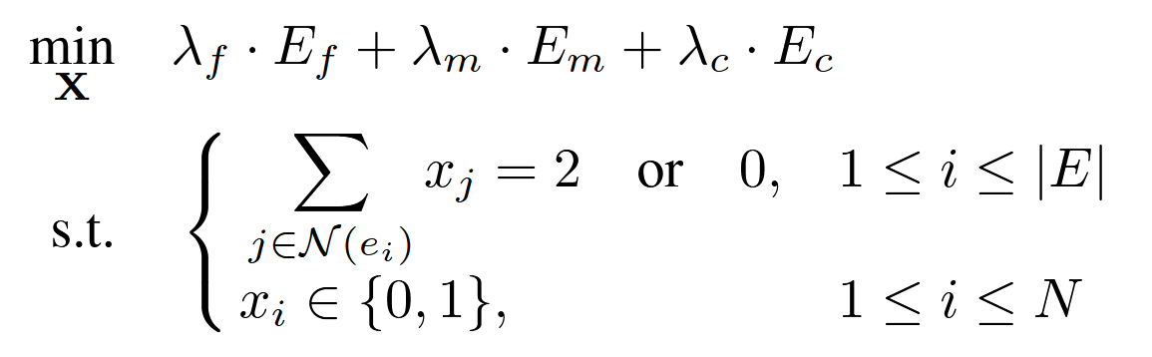
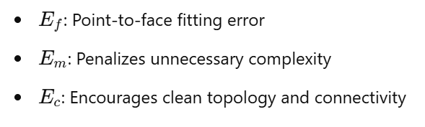
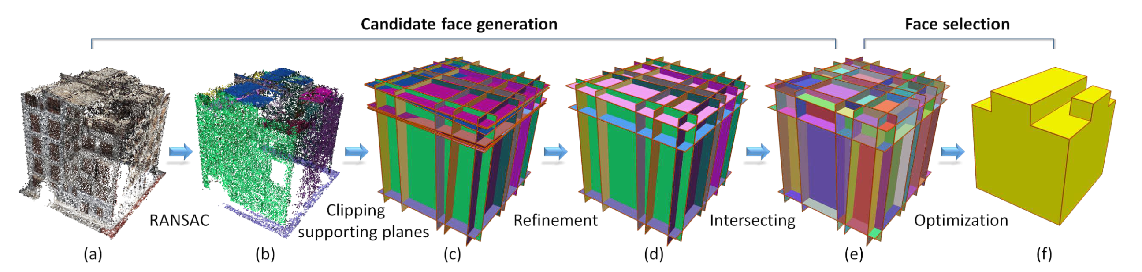
Scan-to-BIM Framework
Data Acquisition
Preprocessing
Geometric Reconstruction
Semantic Segmentation
Modeling
Point Cloud
Geometry
Geometric Reconstruction: Determine geometry of building elements
Achieved with PolyFit Software by Nan & Wonka (2017)
Candidate Face Generation: Generates many planar faces RANSAC, …
Face Selection: Selects optimal faces Optimization Problem (Integer Linear Programming)
Notes:
Then, I use a surface reconstruction tool called PolyFit.
It provides the geometry for the later BIM model.
First, PolyFit uses the RANSAC algorithm to detect planar faces. After that, it finds the optimal faces with integer linear programming
The objective function includes three energy terms.
And with the lambda weights the output model can be controlled.
And this constraints ensures that the final result is a watertight model - so there are no holes. It makes the model quite robust.

Slide 21
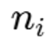
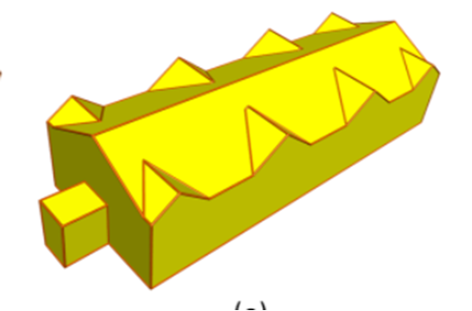
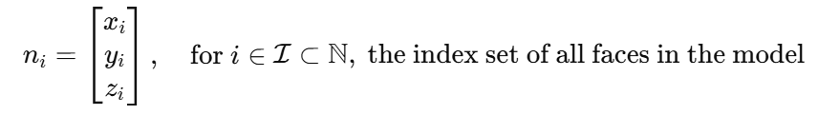
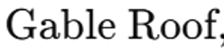
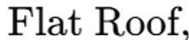
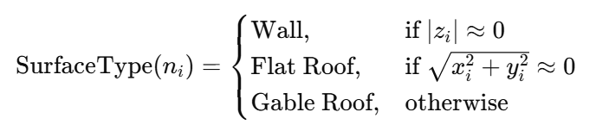
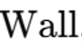
Scan-to-BIM Framework
Data Acquisition
Preprocessing
Geometric Reconstruction
Semantic Segmentation
Modeling
Geometry
Semantic
Semantic Segmentation: Determine semantics of building elements
Feature Extraction: Selecting useful information from data Normal Vector
Classification: Labeling data points Rule Based Classification
Notes:
After that, the objects still needs semantics.
1. For that, I compute the normal vector of each face.
2. Then, I use the vectors as a rule-based classification metric.
I do it that way because I don’t have training data for a supervised machine learning approach.
So, at the end I have the geometry and semantic for each face.

Slide 22
Scan-to-BIM Framework
Data Acquisition
Preprocessing
Geometric Reconstruction
Semantic Segmentation
Modeling
Drawings
Geometry
Semantic
BIM Model
Modeling: Integration of geometry and sematic in BIM-Software
Automated Model Generation: Automatic generation of building elements ?
Model Refinement: Import and manual refinement in BIM software LOD enhancement (windows, doors), ?
Derivation of 2D drawings
Notes:
The final step is the modeling. It’s still quite open.
My goal is to create the building elements in Python and then export them to Revit.
Maybe I will work with Dinamo. But so far, I don’t know either of them.
The final product should then be a building permit drawing that meets the requirements of the Zurich building authority. That is our defined DoD.

Slide 23
Where am I standing?
Problem Identification
Objectives
Design and Development
Demonstration
Evaluation
Communication
Data Acquisition
Preprocessing
Geometric Reconstruction
Semantic Segmentation
Modeling
Challenges:
Implementation of PolyFit (C++) in Python is not yet working
Difficult to estimate the complexity of the modeling due to lack of BIM experience
Evaluation methodology is still undecided
Writing report (and other courses) takes more time than expected - leaving little time for coding 😔
Notes:
This slide provides an overview of my current status and my key challenges.

Slide 24
Thank you
Happy to hear your suggestion! ☺
Notes:
Thank you for your attention, and feel free to ask questions now

Slide 25

Thank you
Questions?
Creative improvements always welcome! ☺
GitHub
Telecom
Site Planning
Geomatics
Scanning
Construction
BIM
Automation
Automation
Notes:
Thank you very much!

